Slide 1
Data types
A Lecture for the c++ Course
Each slide has its own narration in an audio file. For the explanation of any slide, click on the audio icon to start the narration.
The Professor‘s C++ Course by Linda W. Friedman is licensed under a Creative Commons Attribution-NonCommercial-ShareAlike 3.0 Unported License.

Slide 2
About data types
A data type is a template for
how a particular set of values is represented in memory, and
what operations can be performed on those values.
In C++ a type is the same as a class.
There are
predefined data types
system-defined types
user-defined types

Slide 3
About data types
Predefined data types are part of the C++ language definition.
Examples: float, double - real. int - integer. char
We denote char literals with single quotes, for example: ‘A’ ‘*’ ‘2’
A string literal is a sequence of characters in double quotes:
“ABCDE”
“127” (not the same as int 127)
“true” (not the same as bool true)
System-defined types - part of the C++ class libraries. Not part of the original C++ language definition but added when the compiler is written.
The standard I/O stream objects cin and cout are defined in iostream library
Also there is a string class (type) and classes for input and output files.
To declare an output file: ofstream cprint (“file.txt”);
User-defined types - e.g., enum type, classes

Slide 4
declarations
Declarations inform the compiler that it will need to set aside space in memory to hold an object of a particular type (class) with a particular name.
Constant declarations
Used to associate meaningful names with constants -- items that will never change throughout the execution of the program.
One convention is to use all uppercase letters for constant identifiers.
const float PI=3.14159;
const float METERS_TO_YARDS=1.196;

Slide 5
declarations
Variable declarations:
Used to associate identifiers of a given type with memory cells used to store values of this type. - the values stored in the data cells are changeable.
char letter;
char letter1, letter2;
float x, y;

Slide 6
declarations
Object declarations
Like variables, these are used to associate identifiers of a given type with memory cells used to store values of this type. - the values stored in the data cells are changeable. We use some system-defined classes in the standard C++ class libraries. A class is equivalent to a type; variables can store data values and are called objects.
ofstream cprn (“printfile.txt”);
class
object

Slide 7
Data type: int
The variable’s type (or class) tells the compiler how the variable’s values are to be stored and how they may be used.
There are nine int types:
short int unsigned short int char
int unsigned int signed char
long int unsigned long int unsigned char
The differences among these 9 types are due to the range of values each allows. These ranges may depend somewhat on the computer system.
short is the same as short int
On some computers (DOS PCs) the int set of values consists of all integers in the range –32,768 to 32,767. [Why?]

Slide 8
Data type: char
char type uses 8 bits to store a single character. Is actually a numeric type in that it stores the ASCII (American Standard Code for Information Interchange) code value of the character. Character input is automatically converted; on output the value is converted to the equivalent char first.
char, signed char, unsigned char
Use unsigned char for a very short bit-string. Depending on the system, char will be equivalent to either signed char or unsigned char.

Slide 9
Data type: char
examples using char data type:
char c = 54;
char d = 2 * c – 7;
c++ ;
…
…
char c = 64;
cout << c << “ “; //prints ‘@’
c = c + 1; //increments c to 65
cout << c << “ “; //prints ‘A’
c = c + 1; //increments c to 66
cout << c << “ “; //prints ‘B’
c = c + 1; //increments c to 67
cout << c << “ “; //prints ‘C’
…

Slide 10
Data type: char typecasting
We can convert char to int. The int(char) function is a cast. In this next example, it converts c from char type to int type:
#include <iostream>
using namespace std;
void main (){
char c = 64;
cout << c << " is the same as " << int(c) << endl;
c = c+ 1;
cout << c << " is the same as " << int(c) << endl;
c = c+ 1;
cout << c << " is the same as " << int(c) << endl;
c = c+ 1;
cout << c << " is the same as " << int(c) << endl;
return;
}
This is called typecasting – we can also cast, e.g., float(c); int(fl); …

Slide 11
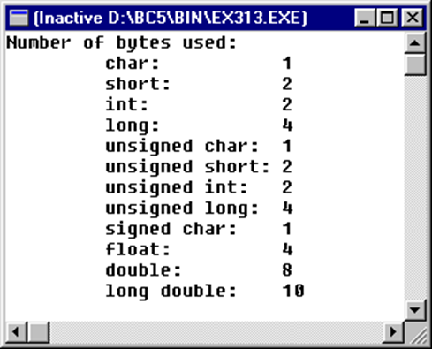
Real number types
A real number is a value that represents a quantity along a continuous line.
In C++ we can use the types float, double, and long double.
On most systems, double uses twice as many bytes as float. In general, float uses 4 bytes, double uses 8 bytes, and long double uses 8, 10, 12, or 16 bytes.
We can always use a program to determine how a type is stored on a particular computer. The program on the next slide produced this output:

Slide 12
Real number types
// Prints the amount of space each of the 12 fundamental types uses.
// From Hubbard book
#include <iostream>
using namespace std;
void main(){
cout << "Number of bytes used:\n ";
cout << "\t char: " << sizeof(char) << endl;
cout << "\t short: " << sizeof(short) << endl;
cout << "\t int: " << sizeof(int) << endl;
cout << "\t long: " << sizeof(long) << endl;
cout << "\t unsigned char: " << sizeof(unsigned char) << endl;
cout << "\t unsigned short: " << sizeof(unsigned short) << endl;
cout << "\t unsigned int: " << sizeof(unsigned int) << endl;
cout << "\t unsigned long: " << sizeof(unsigned long) << endl;
cout << "\t signed char: " << sizeof(signed char) << endl;
cout << "\t float: " << sizeof(float) << endl;
cout << "\t double: " << sizeof(double) << endl;
cout << "\t long double: " << sizeof(long double) << endl;
return;
}

Slide 13
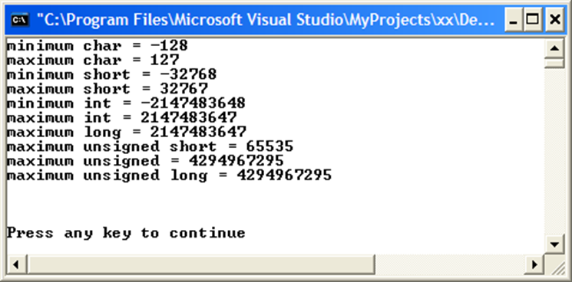
How large a value can I use?

Slide 14
How large a value can I use?
// From Hubbard book
#include <iostream>
#include <limits>
using namespace std;
void main(){
cout << "minimum char = " << CHAR_MIN << endl;
cout << "maximum char = " << CHAR_MAX << endl;
cout << "minimum short = " << SHRT_MIN << endl;
cout << "maximum short = " << SHRT_MAX << endl;
cout << "minimum int = " << INT_MIN << endl;
cout << "maximum int = " << INT_MAX << endl;
cout << "maximum long = " << LONG_MAX << endl;
cout << "maximum unsigned short = " << USHRT_MAX << endl;
cout << "maximum unsigned = " << UINT_MAX << endl;
cout << "maximum unsigned long = " << ULONG_MAX << endl;
cout << endl << endl << endl;
return;
}

Slide 15
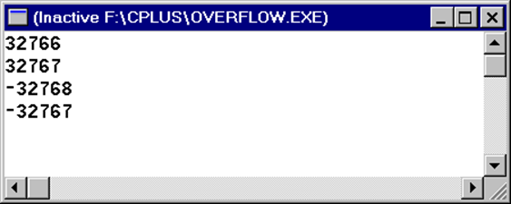
Overflow
What happens if we try to store a value that is too large for the data type to handle? We have an overflow condition. This is a run-time error.
// From Hubbard book
#include <iostream>
#include <limits>
using namespace std;
void main(){
short n= SHRT_MAX - 1;
cout << n++ << endl;
cout << n++ << endl;
cout << n++ << endl;
cout << n++ << endl;
return; //successful termination
} //end main

Slide 16
Review
What did we learn in this lecture? Plenty. Some terms to jog your memories:
cast
char literal
constant
constant declaration
enum class
literal
overflow
predefined data types
real number type
string literal
system-defined types
typecasting
user-defined types

